Slide 1
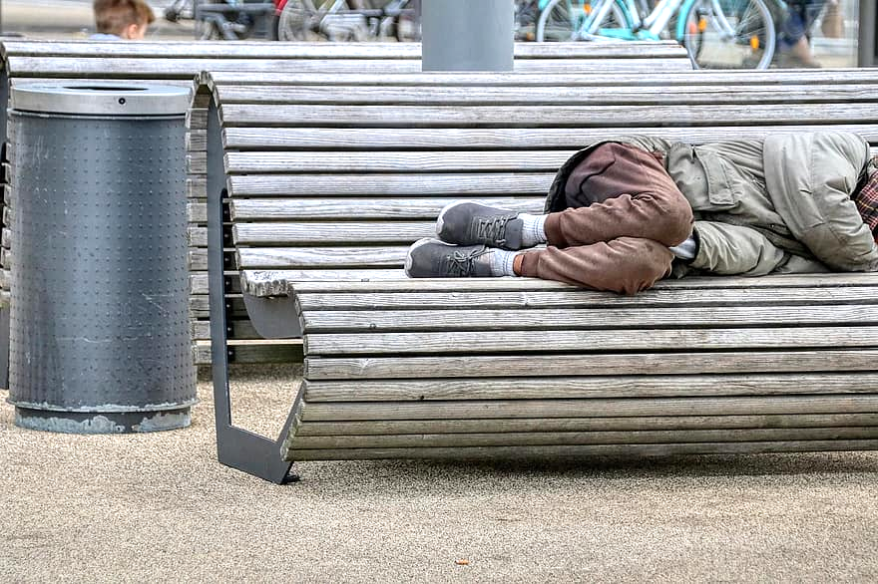
Analysis on homeless population in the US
Data science makes our society better
Group 5
Ian Kinney, Jessica Solomon, Matt Barlow, Nathan Haile, Jaeik Park

Slide 2
Objectives :
Analyzing and understanding the characteristics of US homeless population.
Change in homeless population by year / state
Homeless population analysis by demographics
Identifying potential factors that could have influenced the homeless population in the United States (2017 through 2020).
Homeless population % growth by year (before pandemic vs. after pandemic)
Relationship between homeless population vs. State population
Comparing how states/territories support their homeless population.
Relationship between homeless population vs. Total counts of beds in shelters by year
Conclusion / Suggestion (in view of policy maker)

Slide 3
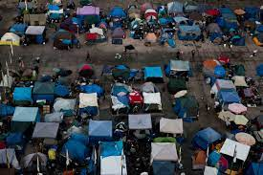
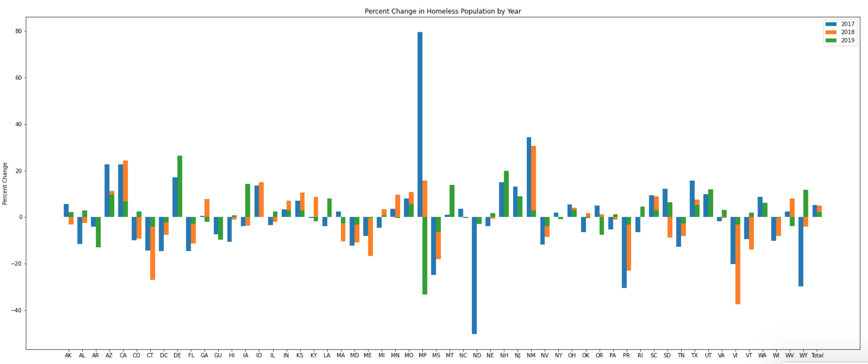
Recent Increase in Homeless Population
Recent years (2017-2019) show a steady percent increase each year in Homeless Population.
The bar chart shows the major outliers, such as the Northern Maria Islands.
New Mexico, California, Arizona, and Texas have a steady percent increase since 2017.

Slide 4
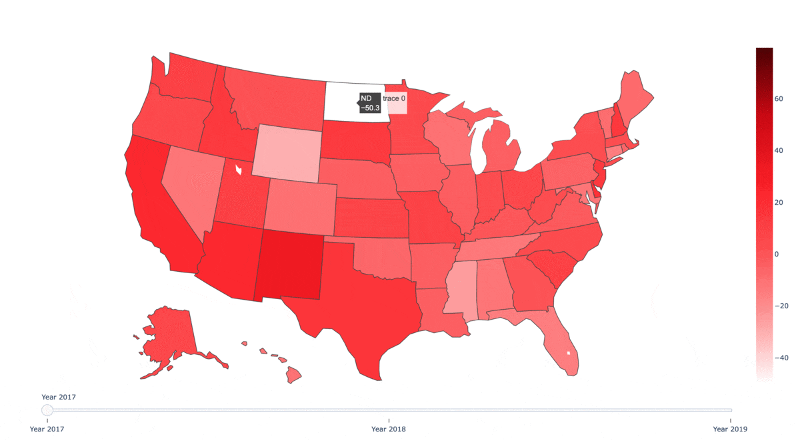
High Increase in Specific States
New Mexico and California have dramatic increase in 2018.
Delaware has dramatic increase in 2019.
Notes:
New Mexico: 30.7% in 2018
California: 24.3% in 2018
Delaware: 26.5% in 2019

Slide 5
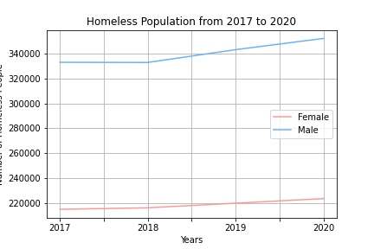
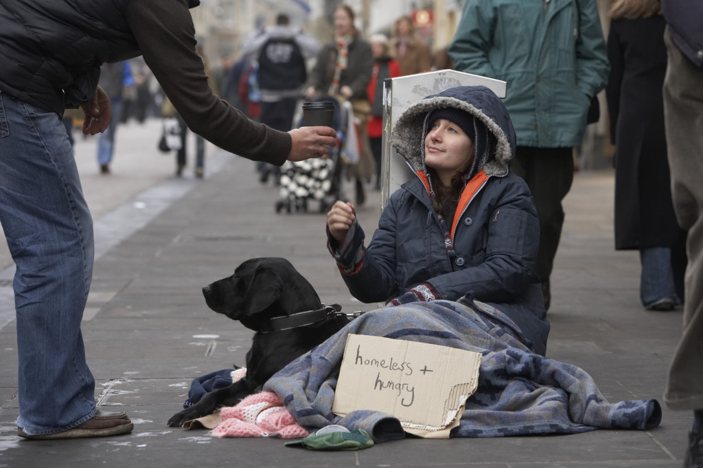
Homeless Population Demographics: Gender
Uptick in both male and female homeless population starting 2018.
Male homeless population consistently higher than that of the female population.
https://www.mentalhealthportland.org/homeless-women-once-a-rarity-now-represent-40-percent-of-people-on-streets/

Slide 6
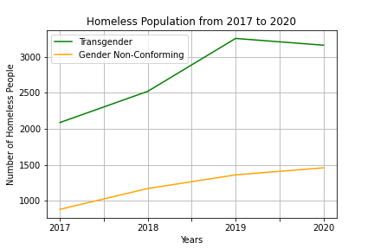
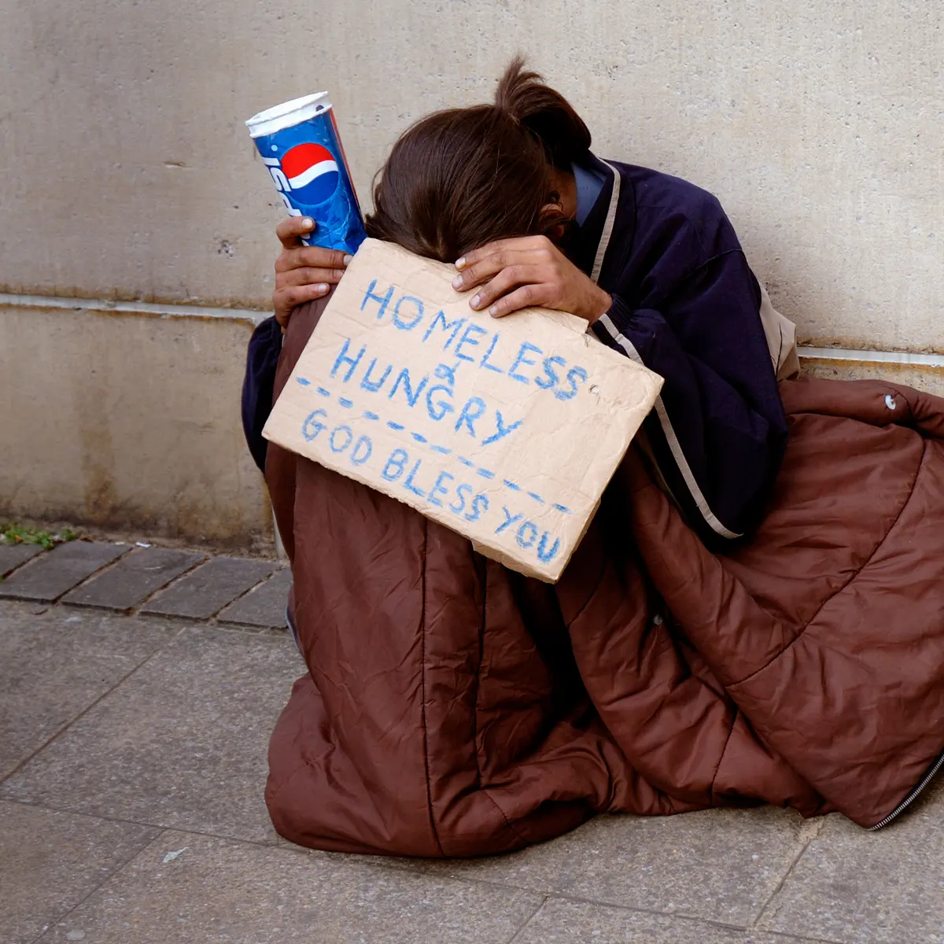
Homeless Population Demographics: Gender
Slight downturn in transgender population in 2020
Decrease in rise of gender non-conforming population in 2020
A young homeless person. The number of homeless people who are trans and gender diverse has ‘simply exploded’. Photograph: Alamy Stock Photo

Slide 7
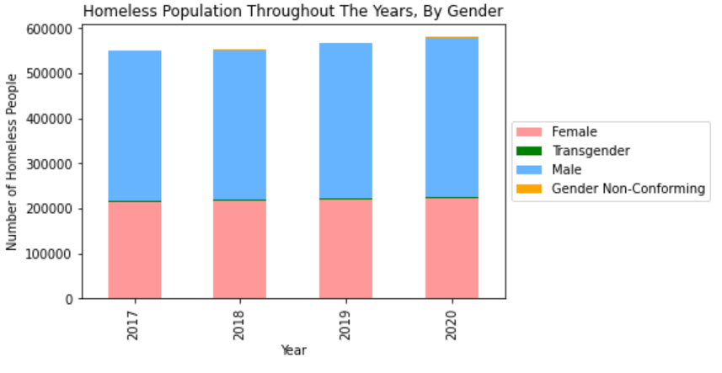
Homeless Population Demographics: Gender

Slide 8
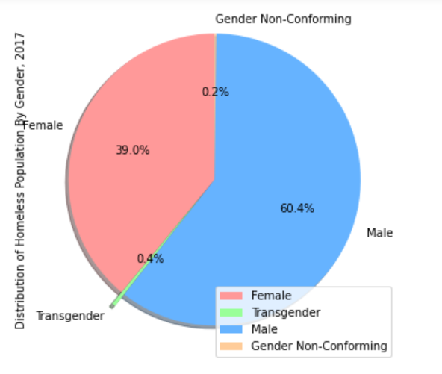
Homeless Population Demographics: Gender

Slide 9
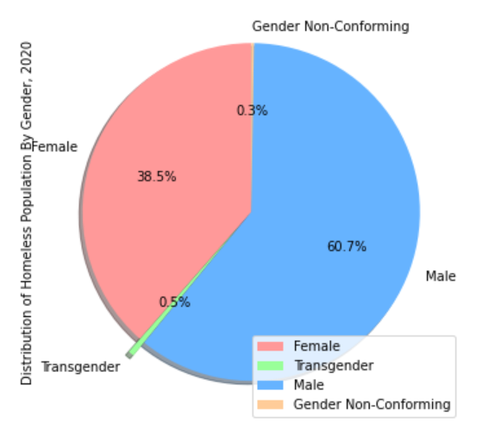
Homeless Population Demographics: Gender
3 Yrs

Slide 10
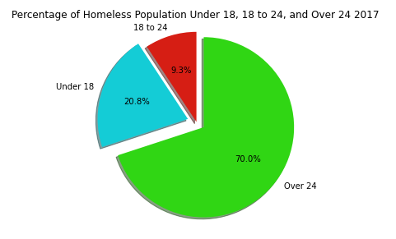
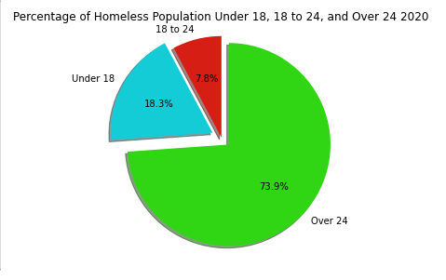
Homeless Population Demographics: Age
3 Yrs
Notes:
From 2017 to 2020
Homeless Population ‘Under 18’ has decreased by 8,165
Homeless Population ‘18 to 24’ has decreased by 5,749
Homeless Population ‘Over 24’ has increased 43,384

Slide 11
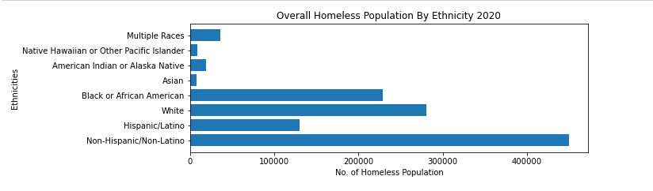
Homeless Population Demographics: Ethnicity

Slide 12
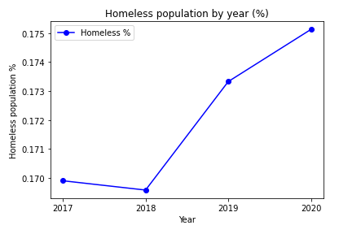
Homeless population % growth by year
Obviously, pandemic affects homeless population.
Before pandemic, Homeless population accounts for 0.170% of total US population.
After pandemic, it increased up to 0.175%
For 4 years, homeless population increased by approx. 30,000 people.
Year 2017 : 550,996
Year 2020 : 580,466

Slide 13
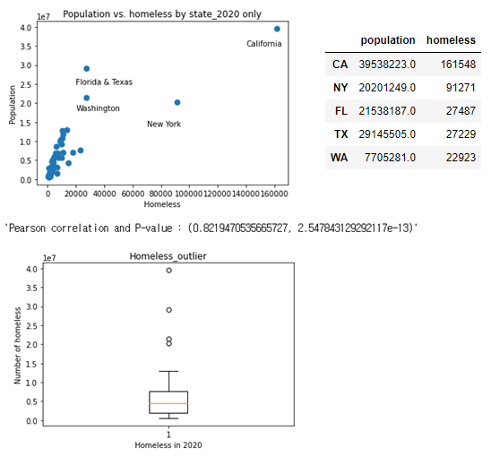
Relationship between homeless population vs. State population (2020)
Population positively correlates (+0.82) with state population (P value : < 5%)
Ref. It turns out homeless population dataset has 5 outliers.
It would be interesting to look into more variables to better explain
Income
Demographics

Slide 14

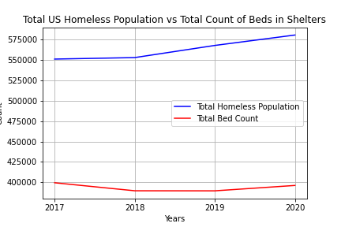
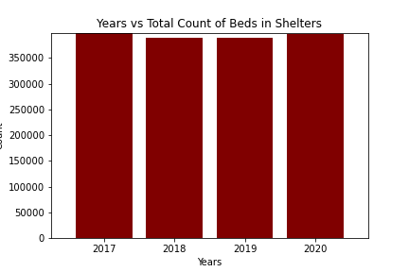
Homeless Resources : Homeless Population Vs Beds Count
Looking at the data and graphs, the nation is inadequately equipped to meet the needs of the growing homeless population.
Also, notice in 2018 the spike in homeless population but a diversion in Total Bed count in homeless shelters. You would think there would be a spike in homeless shelter beds and resources to support it but that’s not what the data shows.

Slide 15
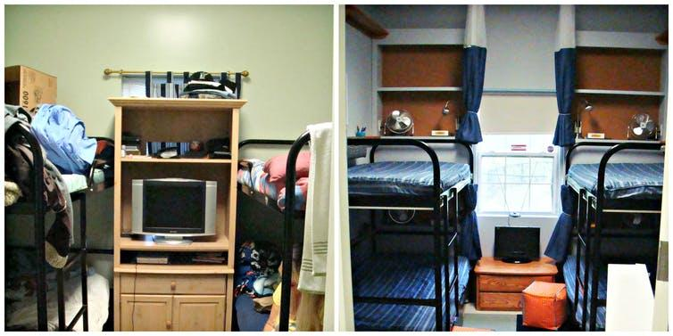
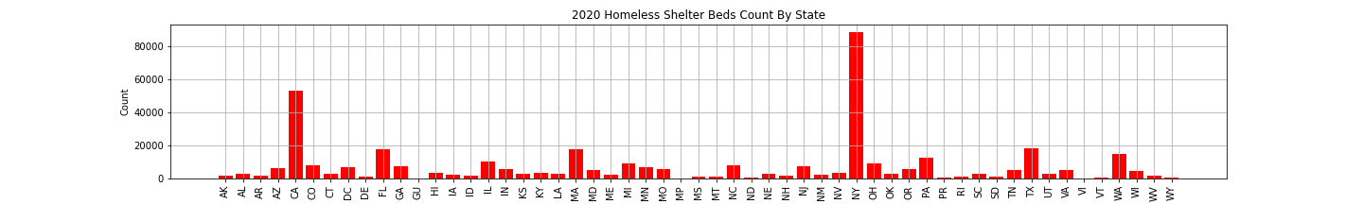
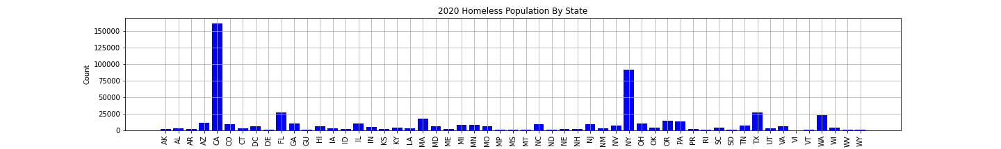
Homeless Resources : Bed Count By State
With these bar charts you can see the outlier populations being in California and New York.
Also this data shows New York, even though has a large homeless population is more equipped with beds in homeless shelters with California who is lagging behind immensely.
Jill Pable, Author provided

Slide 16
Conclusions / Suggestions
The homeless population is steadily increasing across the United States, especially in states with major cities.
Next steps should be comparing the total population from each gender with that of the homeless population.
XXX
Pandemic contributes increase in homeless population in the US. We need better care/policy to protect them from Covid-19.
The country does not have enough resources to combat the homeless population
Notes:
Maybe talk about the “dirty work” we did when discussing experience with data

Slide 17
Supplementary Slides

Slide 18
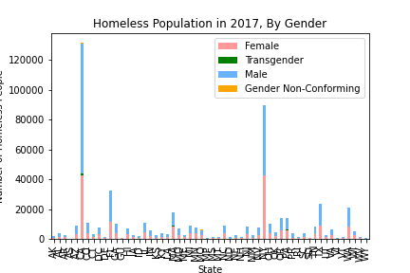
Notes:
Filter out states (NY, California, NM, GA, AZ, Delaware)

Slide 19
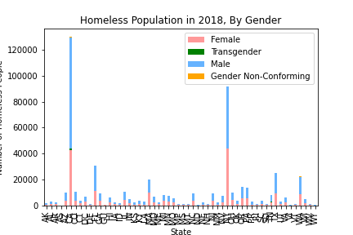
Notes:
Filter out states (NY, California, NM, GA, AZ, Delaware)

Slide 20
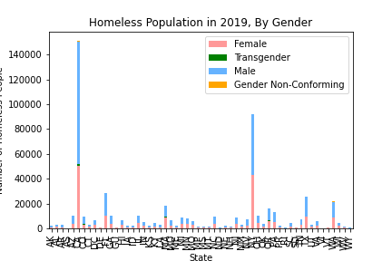
Notes:
Filter out states (NY, California, NM, GA, AZ, Delaware)

Slide 21
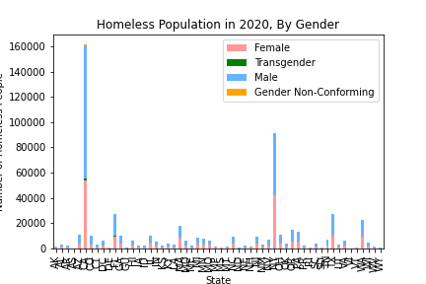
Notes:
Filter out states (NY, California, NM, GA, AZ, Delaware)

Slide 22
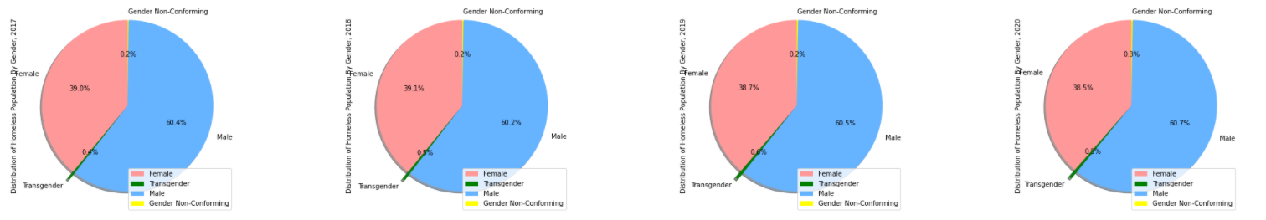
Homeless Population Demographics: Gender
Year | % Female | % Male | % Transgender | % Gender Non-Conforming
2017 | 39.0 | 60.4 | 0.4 | 0.2
2018 | 39.1 | 60.2 | 0.5 | 0.2
2019 | 38.7 | 60.5 | 0.6 | 0.2
2020 | 38.5 | 60.7 | 0.5 | 0.3

Slide 23
